Slide 1


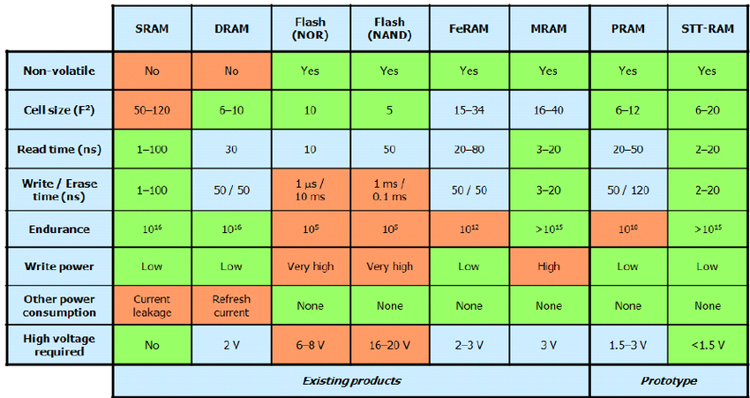
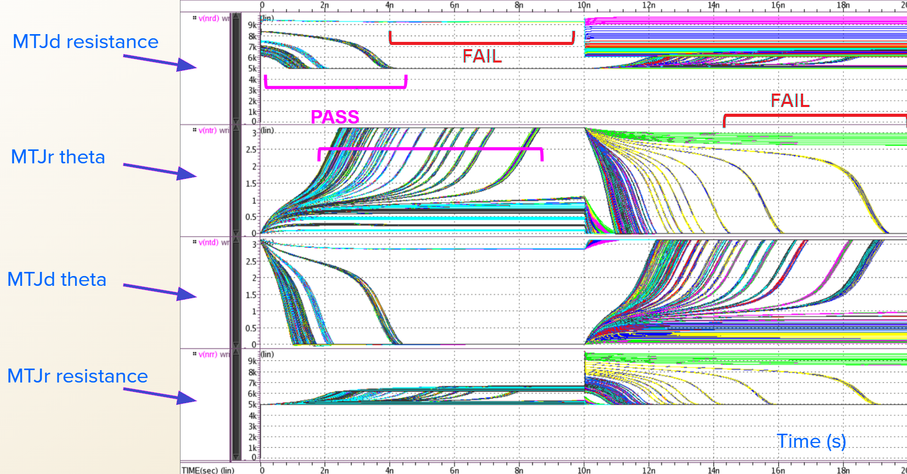
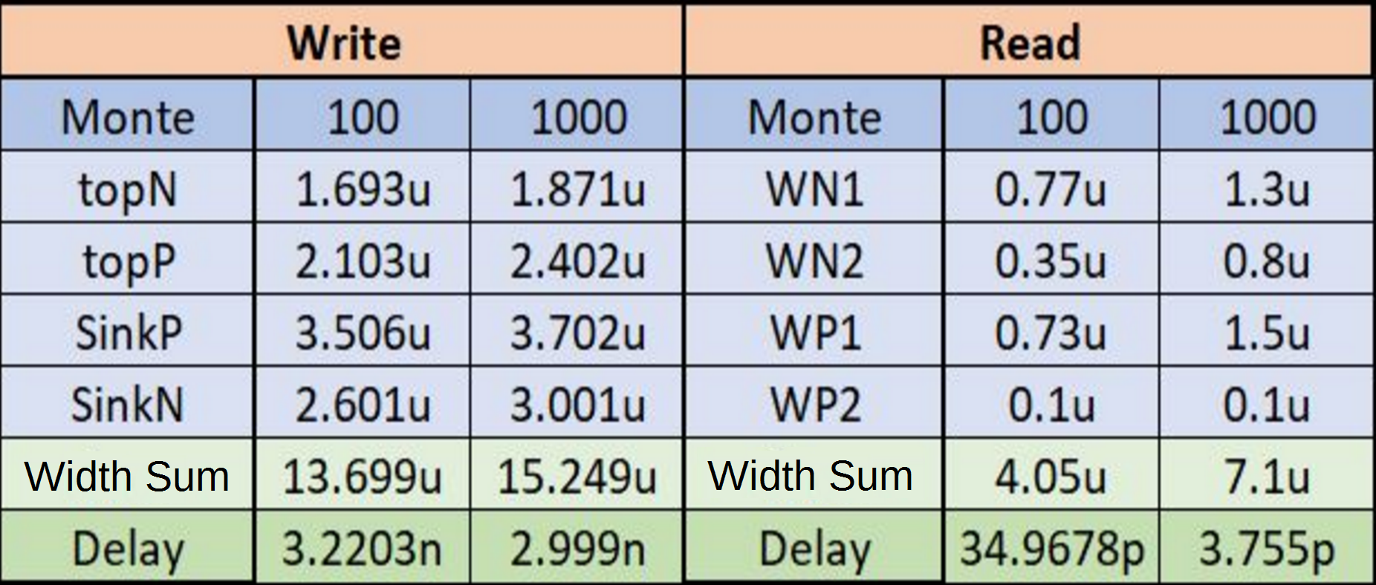
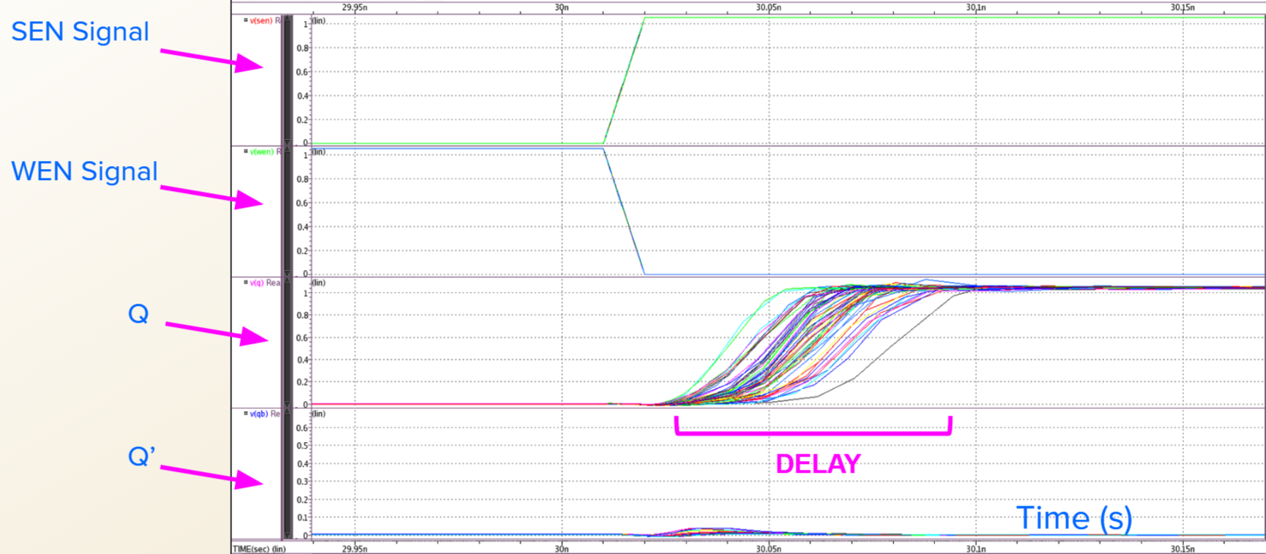
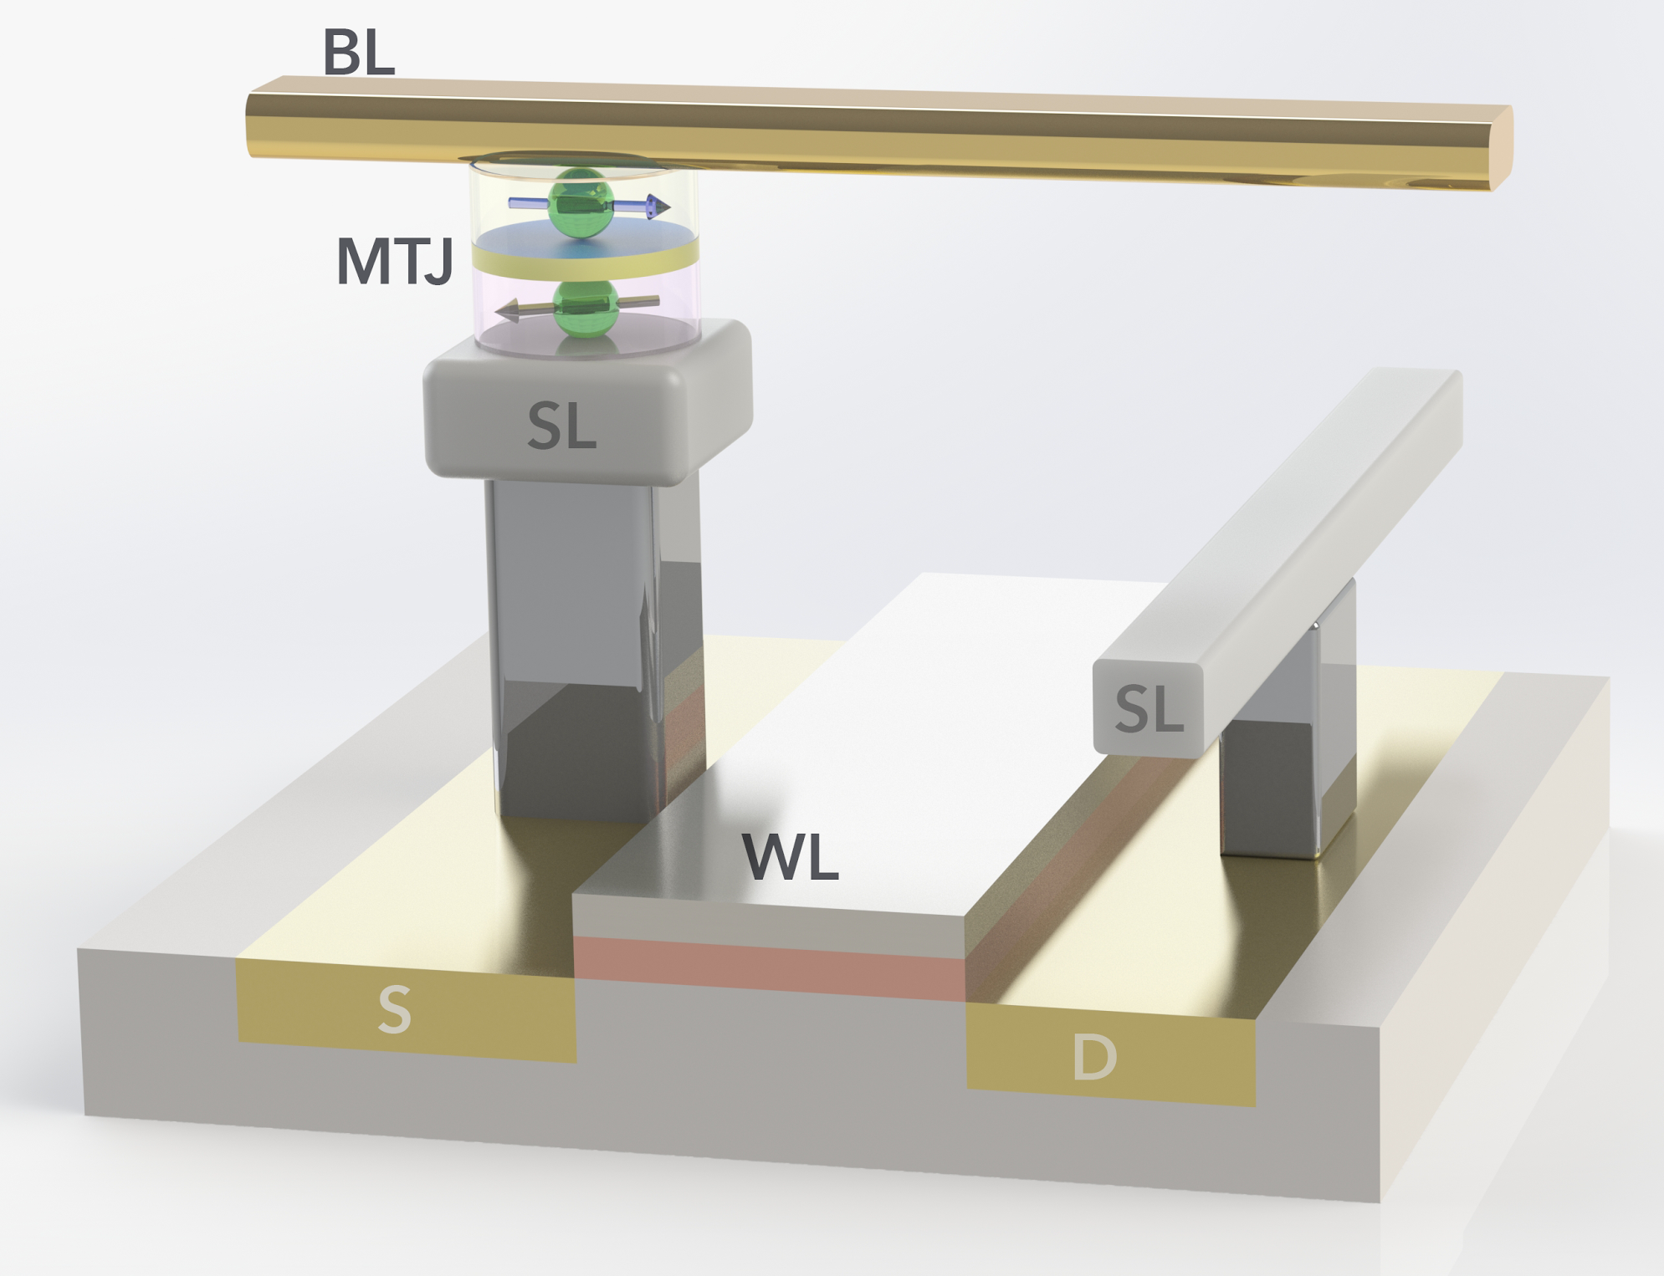
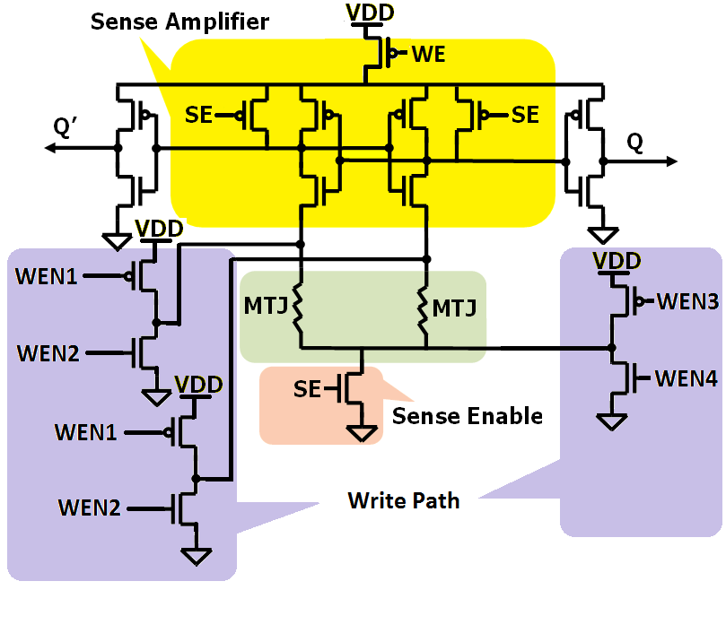
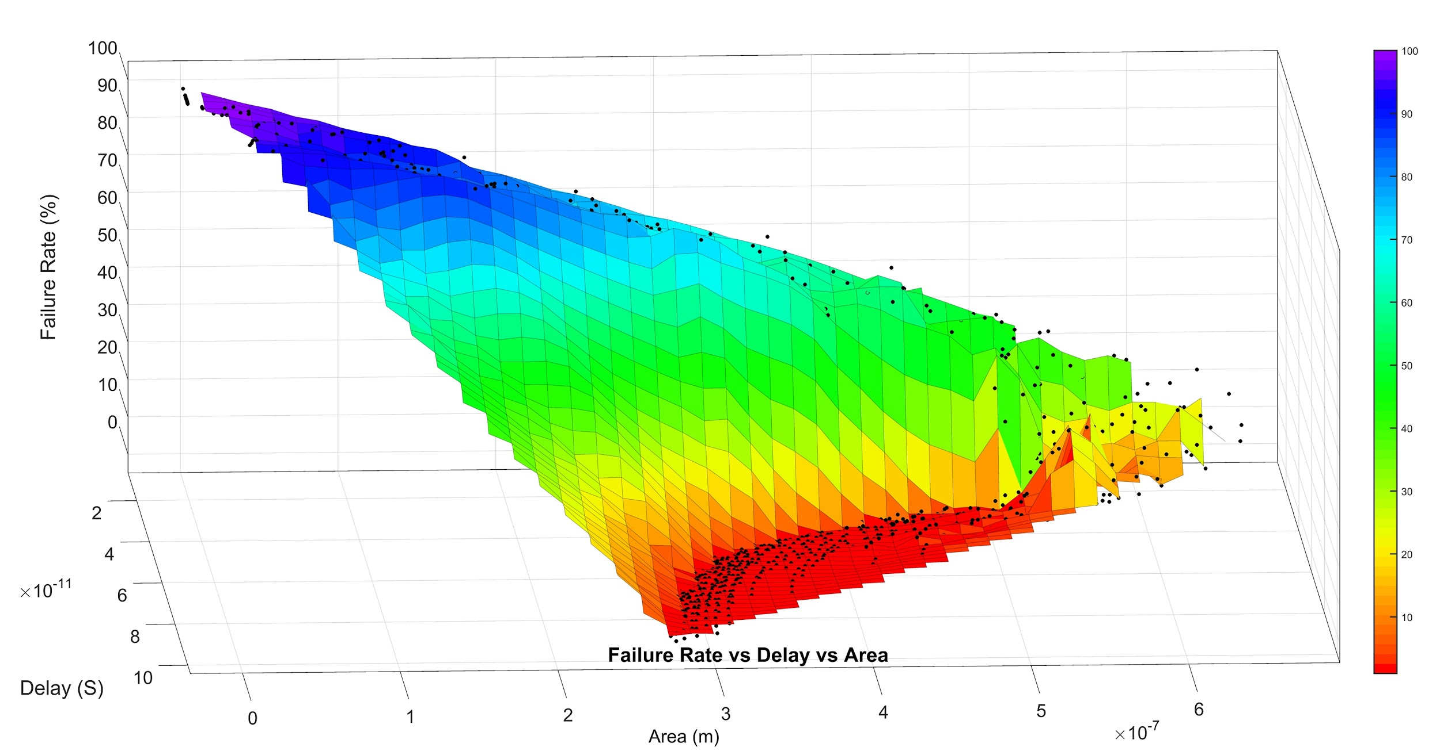
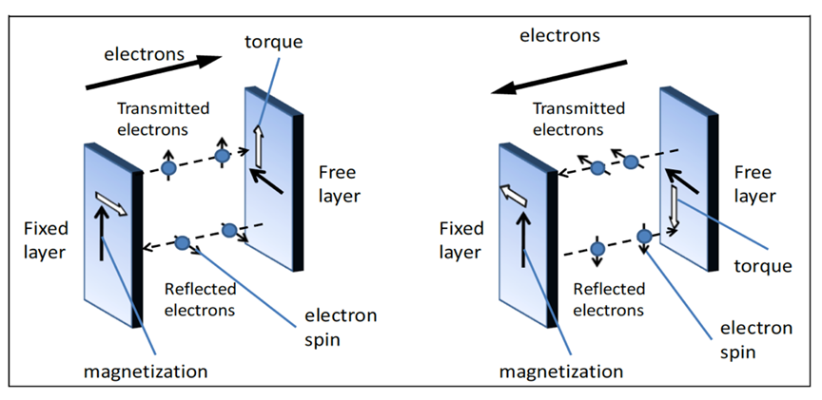
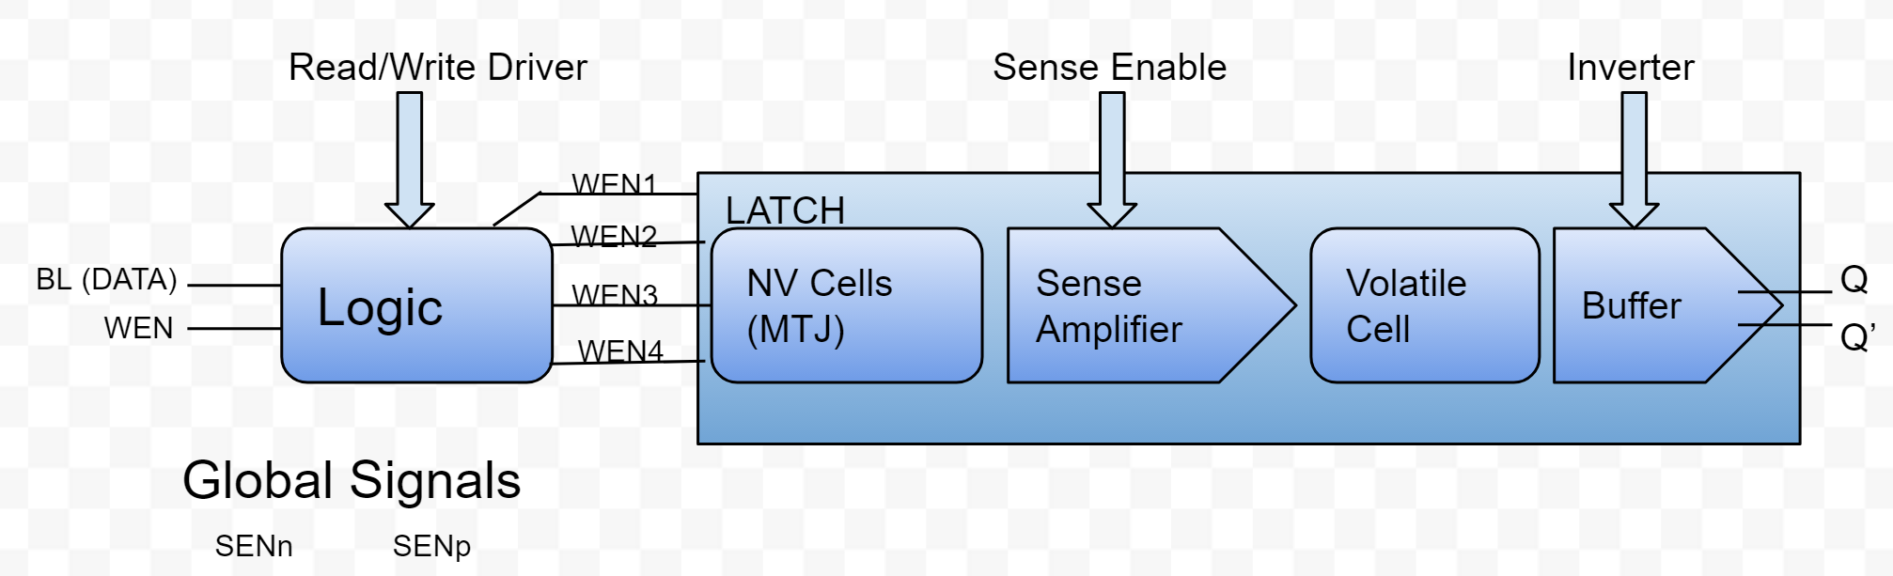
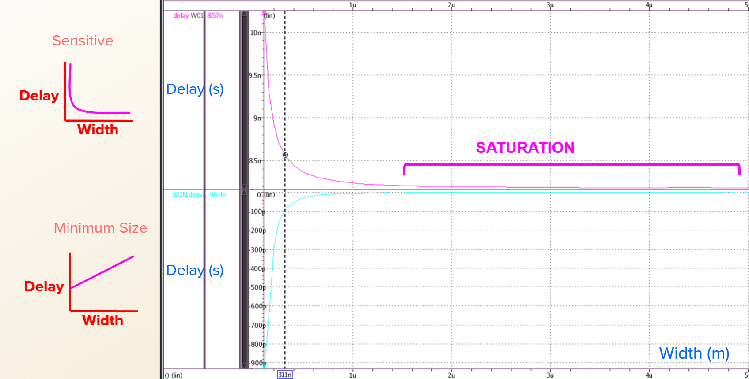
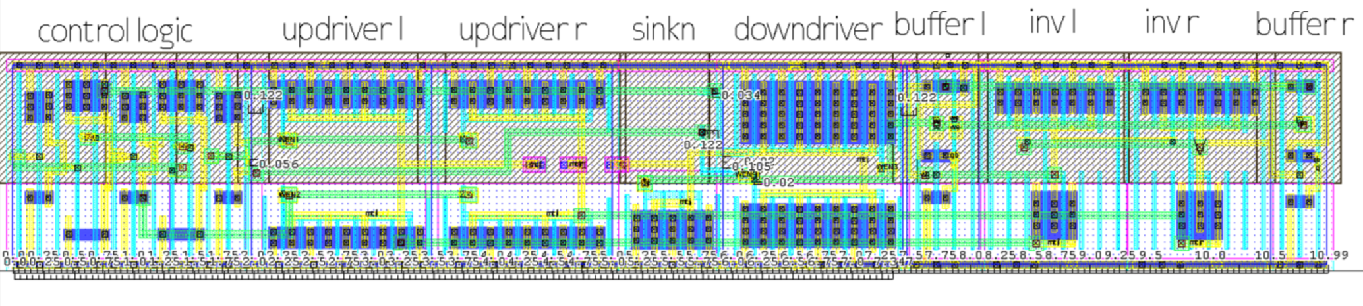
Design and Optimization of Non-Volatile Latch using Resistive Memory Technology
Vladislav Miftakhov¹, Cody Del Prato¹, Søren Tornøe¹, Kwan Lim¹
Graduate Mentor: Aliyar Attaran², Advisor: Hamid Mahmoodi²
¹Cañada College 4200 Farm Hill Blvd. Redwood City, CA 94061
²San Francisco State University: Dept. of Engineering 1600 Holloway Ave. San Francisco, CA 94132
1. Introduction
Logic
Optimization of write (6 Transistors)
6. Results
Modern Semiconductor industry is vulnerable to IP fraud and reverse engineering due to low hardware security and IC fabrication foundries outsourcing semiconductor design.
Figure 1: Table Comparing Characteristics of Memory Technologies
The control logic is composed of two inverters and two nand gates, and it generates the signals to flip the MTJ.
Depending on the direction of the current, values (either 0 or 1) are introduced for the Data and the Write Enable (1-4).
We ran multivariable simulations with four variables to see how the transistor values are affected and to find accurate width values.
Figure 8: Write Operation Width Sweep Simulations
Figure 12: Results of Write and Read Optimization
Figure 5: Truth Table for Write Operation Logic
STT technology poses as a great potential solution. It can be used to improve hardware security by implementing fast, reconfigurable logic to IC design.
Bit-Line (Data) | Wen | WEN1 | WEN2 | WEN3 | WEN4
0 | 0 | 1 | 0 | 1 | 0
0 | 1 | 1 | 1 | 0 | 0
1 | 0 | 1 | 0 | 1 | 0
1 | 1 | 0 | 0 | 1 | 1
Optimization of read (12 Transistors)
Optimization of the read cycle was performed by using HSpice and a netlist that allowed delay and area to be used as weighted goals.
Post Layout write path was rerun with parasitics and results showed the unideal delay of 3.5ns
Post Layout Read Path with parasitics had a delay of 168ps with sensing power of 42.4009 μW. Leakage Power was very low at 1.5594μW at SE frequency of 250 MHz
Post-Layout 1000 iteration Monte Carlo run with parasitics yielded 100% pass rate for both Write and Read Operations
Write and Read Operations
2. Spin Transfer Torque Random Access Memory (STTRAM)
Write Operations
When writing a 0 1 to the pair of MTJs, WEN1 and WEN2 are low, the top NMOS transistors are on, and the top of the circuit is connected to ground while WEN3 allows the bottom PMOS to turn on.
When writing 1 0 to the pair of MTJs, WEN1 and WEN2 are high which allows VDD to be present at the top of the circuit.
Read Operations
During the pre-charge phase sense enable is low and the PMOS at the top of the circuit allows the circuit to be pre-charged with VDD while the NMOS that connects to ground is not active.
During the evaluation phase sense enable is high and the VDD PMOS is inactive while the Grounding NMOS is active and allows the circuit to connect to ground.
The netlist contained a parameter which allowed an area goal to be set so that HSpice would determine the best possible transistor size.
Resistive memory technology to replace traditional charge-based memory.
Information storage by use of magnetic orientation.
CMOS compatibility, scalability, non-volatility,
low power
Figure 9: Read Operation Width Sweep Simulations
Monte Carlo Simulations
A Monte Carlo failure rate netlist program was used to test each set of values recorded in the optimization process.
Each set of our values was run at 1000 iterations to ensure reliability of the circuit to within 0.1% accuracy.
We looked for values that passed simulations with 0% failure rate, which meant a minimum of 99.9% reliability.
The optimization for 100 run Monte Carlo yielded best values that had higher delay, lower reliability, and lower area.
7. Conclusion
Low delay corresponded with low failure rate and thus high reliability. High area and high power consumption corresponded with low failure rate. Higher area and higher power imply higher cost so there was a tradeoff in the optimization. Larger increases in width were needed in the write path than the read path for similar improvements in reliability. Our design has less complexity than alternative designs, such as the Separated Precharge NV Latch with feedback, and is more reliable when scaled to comparable area.
Figure 2: MTJ and Access Transistor
3. Magnetic Tunnel Junction (MTJ)
Composed of an oxide layer in between two ferromagnetic layers; one free and one pinned.
Used to store information
as binary bit.
Resistance is sensed by
applying a current to
MTJs layers.
Information is sensed
as resistances.
Low resistance is logic state 0 & High resistance is logic state 1.
Figure 10: MATLAB Graph of Failure Rate vs Delay vs Area 3D View
Figure 3: Physics of a MTJ from: Iong Ying Loh, Master Thesis, MIT, 2009
Figure 6: Precharge Latch
8. References
[1] H. Mahmoodi, A. Attaran, T. Sheaves, “Design of a Non-Volatile Latch using Resistive Memory Technology”
[2] H. Mahmoodi, S. Srinivasan Lakshmipuramᐩ, M. Aora, Y. Asgarieh, H. Homayoun, B. Lin and D. M. Tullsen “Resisitive Computation: A Critique.” IEEE COMPUTER ARCHITECTURE LETTERS, VOL. 13 NO.2, JULY-DECEMBER 2014
[3] W. Zhao, E. Belhaire and C. Chappert “Spin-MTJ based Non-Volatile Flip-Flop.”
Proceedings of the 7th IEEE International Conference on Nanotechnology August 2-5
2007, Hong Kong
[4]Wicht, Bernhard, Thomas Nirschl, and Doris Schmitt-Landsiedel. "Yield and Speed Optimization of a Latch-Type Voltage Sense Amplifier." IEEE JOURNAL OF SOLID-STATE CIRCUITS , VOL.39 NO.07, JULY 2004
[5]Welser, Jeffrey, S.A. Wolf, and Phaedon Avouris. " 282 CHAPTER 8 APPLICATIONS: NANOELECTRONICS AND NANOMAGNETICS ." Nanotechnology Research Directions for Societal Needs in 2020. London: Springer Dordrecht, 2011.
5. Methodology
4. Design and Parameters
Delay Vs Width Sweeps
Layout
Circuit first created as a schematic and exported as HSPICE netlist.
Added lines of code to Netlist to measure delay, area, and MTJ orientation.
Using the netlist, simulations were run of the full circuit where individual transistor widths were adjusted.
The change in delay due to the changes in transistor widths was then measured for both the Write and Read circuits.
The goal of the layout was to minimize the area the circuit would take up while still being able to perform as desired.
The first test we ran once our layout was constructed was the Design Rules Checking (DRC), which checks to make sure our design follows the current rules and conventions used in manufacturing.
All of the nmos and pmos layers must overlap each other and the VDD and VSS must all be formed into one bar across all instances respectively to create one continuous circuit.
The precharge latch consists of two MTJs as resistive memory cells to hold our data as binary one or zero.
The outputs are the voltage out referenced as Q for the left side of the circuit and Q’ for the right side of the circuit. There are four inputs for the write; WEN1, WEN2, WEN3, and WEN4.
Figure 7: Delay vs Width Graph and Derivative, Sensitivity Analysis
9. Acknowledgements
Thank you to Dr. Hamid Mahmoodi and Ali Attaran for mentoring us in this project with technical, aesthetic, and presentation guidance. Thank you to Synopsys for providing EDA licenses to NECRL and to DARPA for continued funding for this research. We are very grateful for this opportunity brought to us by Dr. Amelito Enriquez and the ASPIRES program.
Figure 4: PreCharge Latch Flow Chart Diagram :
Figure 11: HSpice Full Latch Layout at Optimal Area
Notes:
ile

